Slide 1


Process Concept and scheduling
Ms. Swati Mali
swatimali@gmail.com
K. J. Somaiya College of Engineering
Somaiya Vidyavihar University

Slide 2
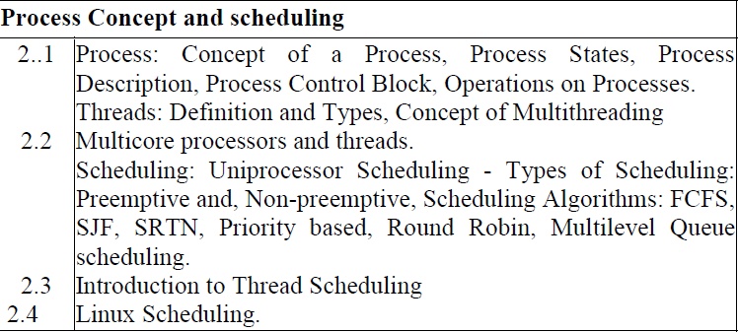

Slide 3
Basic Terminologies & Definitions

Slide 4
Task and Program
Task:
Task is a unit of assigned work.
Can also be defined as the unit of programming controlled by OS.
Depending on the OS design the task may involve one or more processes.
Example: Bake a cake
Program:
A program is defined as sequence of instruction written to accomplish a task.
A program may comprise of one or more processes depending on the statement being executed.
Generally referred as a passive entity that does not perform any action.
Example: A particular recipe given in book.

Slide 5
Process
This is an instance of program in execution.
The static statements in the program when executed, take the process form.
In contrast to the program, a process is an active entity which needs a set of resources to perform its function.
The Linux kernel internally represents processes as tasks.
A process elements are: a program, data and process state.
Example: actually following the steps given the book.

Slide 6
Thread
A thread is a lightweight process.
Also defined as the smallest processing unit that is scheduled by an operating system.
A thread must be part of a process as it shares the process environment viz, code, data and resources with other threads.
Threading has increased the computing efficiency to significant extent.

Slide 7
Job
Job:
A job is unit of work submitted by user to the system.
A job may be interactive or a batch job which may in turn consist of one or more processes.

Slide 8
Process States
Process State:
A process state is a process’ internal data maintained by OS for the purpose of supervision and control of the process.
Also called as executional context of the process.
Process States: (more states, trasitions and reasons for transitions will be discussed later..)
New
Ready
Running
Swapped
Waiting/blocked
Suspended, etc

Slide 9
Process Context
Process Context:
Whenever a running process is taken away from processor, some of the process state’s information needs to be retained.
This information called as process context helps the process to resume from the point where it was stopped last time.
The context of a process includes:
its address space,
stack space,
virtual address space,
register set image i.e. Program Counter, Stack Pointer, Program Status Word, Instruction Register and other general processor registers,
accounting information,
associated kernel data structures and
current state of the process (waiting, ready, etc).

Slide 10
Process Modes
The operational or the privilege mode of process execution is called process mode.
A process executes in user mode or a kernel mode.
Processor switches the process in between these modes depending on the code the process is running.

Slide 11
Event
An activity that is happens or is expected to happen.
Generally this a software message exchanged when the activity occurs.
In operating systems, the events may cause the processes to change their state.
e.g. mouse click, file lock reset, etc.
Check- event viewer in windows OS

Slide 12
Process concepts
Process priority:
In a multiprogramming system, the processes are assigned numerical privileged values indicating their relative importance and/or urgency and/or value.
Preemption:
Preemption is the ability of the system to take over a currently executing process by another one (possibly with high privileged one) with an intention to resume the preempted process later on.
Preemptive:
Preemptive entities are the one those can be taken over by another similar type of entities.
Non-preemptive:
Non-preemptive entities are the one those cannot be taken over by other entities

Slide 13
Degree Of Multiprogramming
With multiprogramming, the CPU can run multiple programs simultaneously or concurrently.
The degree of multiprogramming is the maximum number of allowed processes at a time in a system that does not let the CPU performance degrade than a certain threshold.

Slide 14
Process

Slide 15
Basic elements of a process
Process ID: This is a unique identifier assigned to the process
Code: This is program code.
Data : These are the data and files required for execution
Resources : These are different types of resources allocated by OS
Stack: This contains parameters for the functions/procedures called and their return addresses.
Process state: This is one of the eleven states process is in.

Slide 16
Process state transition
A state transition for process is defined as a change in its state.
The state transition occurs in response to some event in the computing system

Slide 17
States in process state-transition diagram
New: The process is being created
Ready: the process is ready with all required resources and waiting to be assigned to a processor
Waiting/Blocked: the process is waiting for some event to occur
Suspended: the process was waiting for some event to occur, but then is swapped to secondary memory to make room for new processes getting ‘blocked’.
Terminated: the process has finished its execution

Slide 18
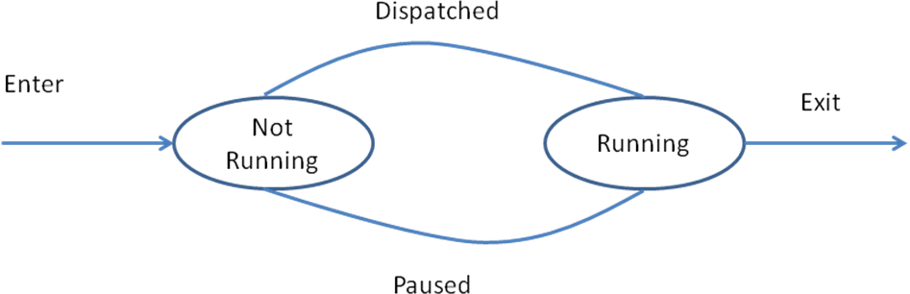
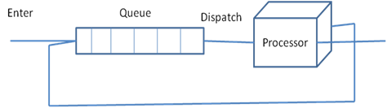
Two State Model

Slide 19
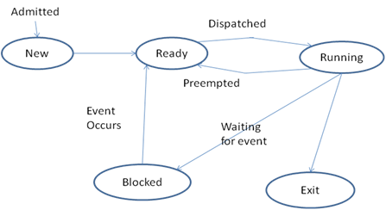

Slide 20
State transition | Description
Null🡪 New | A new process is created to execute a program.
New🡪 ready | The OS may move a process from New to Ready state depending on the predefined maximum number of processes allowed (Degree of multiprogramming).
Ready🡪 Running | The process is scheduled by dispatcher. The CPU starts or resumes execution of the instruction codes
Blocked 🡪 Ready | The request initiated by process is satisfied or the event on which it is waiting occurs.
Running 🡪 Ready | The process is preempted by the OS decides to execute some other process. This transition takes place may be because of expiration of time quantum or arrival of high priority process.
Running 🡪 Blocked | The running process makes request for resource(s) or needs some event to occur to proceed further. The process then calls for a system call to indicate its wish to wait till the resource or the event becomes available.
Running 🡪 Termination | The program execution is completed or terminated.

Slide 21
Causes of process initiation
New batch job: while processing the new batch of jobs submitted, the OS creates a process to execute the same.
Interactive logon: when a user logs into the system, a new process is created.
Created by OS to provide some service: The OS initiates a process to perform the service requested by user directly or indirectly, without making the user to wait.
Spawned by an existing process: To support Modularity and/or parallelism, a user program can create some number of new processes.

Slide 22
How the OS creates a process?
Create a process
Assign a unique process ID to newly created process
Allocate the memory and create its process image
Initialize process control block
Set the appropriate linkages to the different data structures such as ready queue etc.
Create or expand the other data structures if required

Slide 23
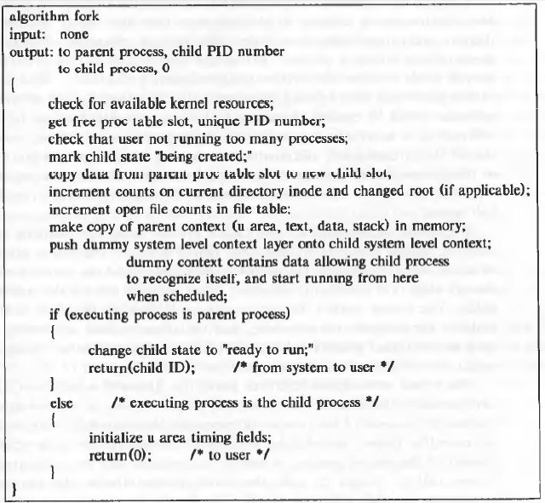

Slide 24
Causes of process blocking
Process requests an I/O operation
Process requests memory or some other resource
Process wishes to wait for a specific interval of time
Process waits for message from some other process
Process wishes to wait for some action to be performed by another process.

Slide 25
Causes of process termination
Normal Completion: The process executes an OS system call to intimate that it has completed its execution.
Self termination (e.g. incorrect file access privileges, inconsistent data)
Termination by the parent process: a parent process calls a system call to kill/terminate its child process when the execution of child process is no longer necessary.
Exceeding resource utilization: An OS may terminate a process if it is holding resources more than it is allowed to. This step can also be taken as part of deadlock recovery procedure.
Abnormal conditions during execution: the OS may terminate a process if an abnormal condition occurs during the program execution. (e.g. memory protection violation, arithmetic overflow etc)
Deadlock detection and recovery

Slide 26
Example Events
Process creation event
Process termination event
Timer event: occurrence of timer interrupt
Resource request event: a resource request is made by a process
Resource release event: process releases a resource and notifies.
I/O initiation request event: a process wishes to initiate I/O operation
I/O completion event: a process finishes I/O operation
Message send event: A message is sent by one process to an another one.
Message receive event: a process receives a massage by another one.
Signal send event: a signal is sent by a process to an another one
Signal receive event: a process receives a signal
A program interrupt: An instruction in currently executing process executes some illegal operation and malfunctions.

Slide 27
A process image
The collection of program, stack, data and process attributes are called process image.
The process image is generally maintained as a continuous or contiguous block of memory which resides in secondary memory.
To execute a process, its process image is loaded in main memory or virtual memory.

Slide 28
Typical Elements of Process Image
Process image element | Description
User Stack | Part of user space that contains program data, a user stack area, and modifiable/editable programs.
User Program | The program under execution.
Stack | Each process needs one or more LIFO stacks to store parameters and return addresses in case of procedure or system calls.
Process Control Block | Process control block(PCB) contains the data which is used by OS to control and manage the process.

Slide 29
Process Control Block
A PCB contains all information pertaining to a process that is used in controlling the process operation, resource information and information needed for inter-process communication.
PCB components:
Identifiers
Processor State Information
Process Control Information

Slide 30
PCB components: Identifiers
PCB Field | Contents
Identifiers
Process ID | This is unique process ID assigned to it at the time of creation
Child and Parent IDs | The child and parent process IDs are required for process synchronization
User Identifier | The unique identifier associated with the user in multiuser systems.

Slide 31
Process Control Information
Scheduling and state information | This is information about process state, priority, scheduling related information and event information in case the concerned process is waiting on that!
Data Structuring | A process may linked to other processes in queue, ring or some other structure. This information is stored in data structuring field.
Interprocess communication | The processes need various flags, messages and signals be exchanged to interact with each other. Some or all this information in stored in PCB.
Process Priority | The priority is a numeric value, which may be assigned to a process at the time of its creation. Some priorities can be altered by user and some change with process age, too.
Memory Management | This field holds the pointer to segments or to the page tables which describe portions of memory assigned to the process.
Resource ownership and Utilization | All the resources or the number of instances of resources assigned to process are described in this field.

Slide 32
PCB components: Process State Information
Processor State Information
User Accessible Registers | Every processor offers some general purpose registers those are accessible to user. The number of available registers differs with every processor type.
Control and Status registers | This field is also called PSW(Program Status Word) which typically contains Program counter (Contains the address of the next instruction to be fetched), Condition codes (Result of the most recent arithmetic or logical operation), Status information(Includes interrupt enabled/disabled flags, execution mode)
Stack Pointers | Each process needs one or more LIFO stacks to store parameters and return addresses in case of procedure or system calls. The stack pointer points to stack top.

Slide 33
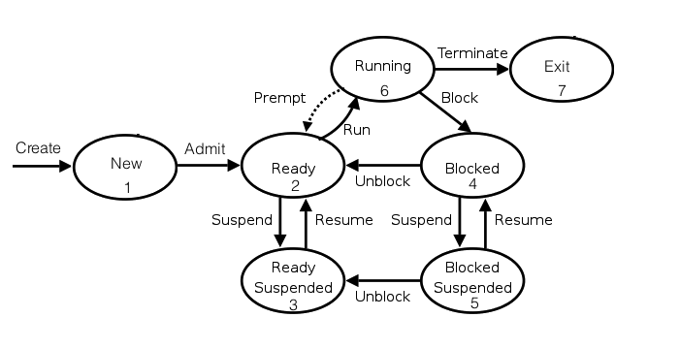
7- state process model

Slide 34
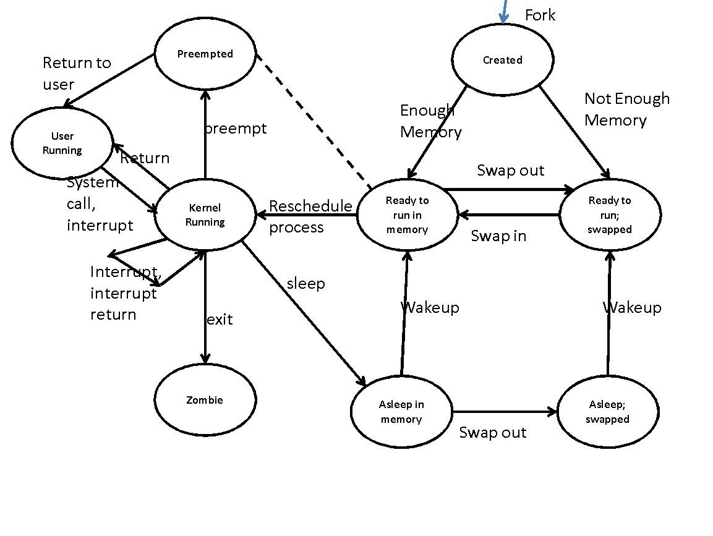
9-state process model

Slide 35
Process State | Description
User Running | The process is running in user mode
Kernel Running | The process is running in Kernel mode
Ready to Run, in Memory | The process is ready to run as soon as the kernel dispatches it.
Asleep in Memory | The process is blocked on some event, process is in main memory.
Ready to Run, Swapped | The process is ready to run, but the swapping module must swap it in the main memory, so that kernel can schedule it.
Sleeping, swapped | The process is blocked on some event and it is in secondary memory.
Preempted | The process was returning from kernel mode to user mode, but the kernel preempts it and performs a process switch to dispatch another process.
Created | The process is just created and is not yet ready to run. (may not have all the resources, including memory, which are required to run)
Zombie | The process no longer exists, but it leaves some information (probably accounting information) to its parent process to collect.

Slide 36
Reasons of process suspension
Swapping: The main memory may not be enough to accommodate some ready process. So a currently not running process is shifted from main memory to secondary memory.
Interactive User request: a user may wish to suspend a currently running process for debugging or to manage the use of resources
Timing: A process may be executed on periodic basis and may be suspended while waiting for its next turn of execution.
Parent process request: A parent process may wish to suspend its child process to examine or modify the suspended process or to coordinate the child processes.
Other OS reasons of suspension: The OS may suspend a background or utility process or a process that is causing some problem in normal activities.

Slide 37
The process switching operation
Process context, including program counter and other registers is saved.
Update the PCB of the process that was currently running state. The new state assigned may be one of the other states (Ready, Blocked, Ready/Suspend or Exit).
Move this updated PCB to appropriate queue (Ready; Blocked on Event i; Ready/Suspend).
Select another deserving process for execution.
Update the PCB of chosen process and change the process state as Running.
Update the memory management data structures.
Restore the context of the chosen process so that it can resume from the point if it was interrupted last time, or can start its execution if it was loaded for the first time.

Slide 38
Process context switch Vs mode switch
Context Switch:
Execution of a process is stopped to respond an interrupt.
Needs to save Process Image be saved of one process and load process image of the new process loaded.
The processes are switched and processes keep on changing their status as Running and Not running.
Mode switch:
Every process may switch in between a low privileged user mode and high privileged kernel mode in its lifetime.
Process continues to execute even after mode switches

Slide 39
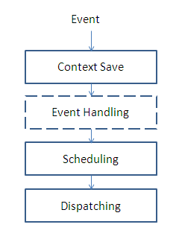
Fundamental kernel functions of process control
Scheduling: Choose the process as per the scheduling policy to be executed next on the CPU.
Dispatching: Set up execution of the chosen process on the CPU.
Context save: Save information concerning an executing process when its execution gets suspended

Slide 40
Fundamental kernel functions of process control
Occurrence of the event calls the context save functionality and an appropriate event handling procedure.
Event handling may initiate some processes, hence the scheduling function gets invoked to choose the process and in turn,
The dispatching function transfers control to the new process.

Slide 41
Control/Data structures maintained by OS to manage processes
Memory Tables
I/O Tables
File Tables
Process table

Slide 42
Control structures maintained by OS to manage processes
Memory Tables:
Memory tables keep track of both main and secondary memory.
Active processes are stored in main memory and when required, they are moved to secondary memory through the mechanism called ‘swapping’.
The memory tables maintain the following information:
The main memory allocation to all processes in system
The secondary memory allocation to all processes in system
Shared memory regions in main and virtual memory and their attributes
Miscellaneous information required to manage virtual memory.

Slide 43
Control structures maintained by OS to manage processes
I/O Tables:
I/O tables keep track of I/O devices and channels in the computing system.
The I/O devices are also resources required by processes.
So at any given instance, I/O devices may be available or allocated to a particular process.

Slide 44
Control structures maintained by OS to manage processes
File Tables:
File tables keeps track of;
all files,
their locations on secondary memory,
their current statuses and
other attributes such security, sharing, etc.
Most of the operating systems, this information is maintained by a module called File Management System.

Slide 45
Control structures maintained by OS to manage processes
Process table:
Process tables manage processes.
They maintain information of:
processes,
their child process references,
statuses,
allocated resources,
process contexts,
information required for process synchronization and so on.
These pieces of information are stored in process images.

Slide 46
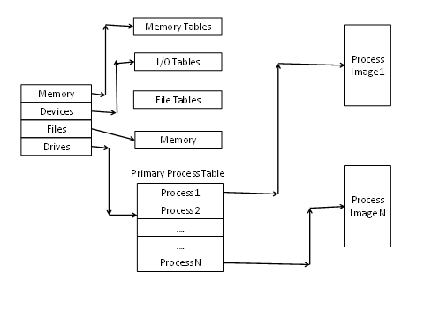

Slide 47
Different interaction mechanisms used by processes
Interaction Mechanism | Description
Data Sharing | The processes interact with each other by altering data values. If more than one processes update the data the same time, they may leave the shared in inconsistent state. So, shared data items are protected against simultaneous access to avoid such situation.
Message Passing | In this mechanism, the processes exchange information by sending messages to each other.
Synchronization | In certain computing environments, the processes are required to execute their actions in some particular order. To help this happen, the processes synchronize with each other to maintain their relative timings and execute in the desired sequence.
Signals | The processes may wait for events to occur. It can be intimated to processes through the signaling mechanism.

Slide 48
Process and thread
Process: an instance of program in execution
Thread : a dispatchable unit of work

Slide 49
Traditional process
Single thread of execution
Needs entire process context to execute so considered as heavyweight
Doesn’t support multiple parallel executions
E.g. you wouldn’t get notifications in background if you are using the app

Slide 50
Thread
Supports Parnellism with multiple threads of execution at a time
A thread executes sequentially and is interruptable so that the processor can turn to another thread
Does not need entire process context to execute so considered as lightweight
Includes the program counter and stack pointer) and its own data area for a stack
Supports multiple parallel executions
e.g. Notifications in background while you are using the app
The idea is to achieve parallelism by dividing a
process into multiple threads.

Slide 51
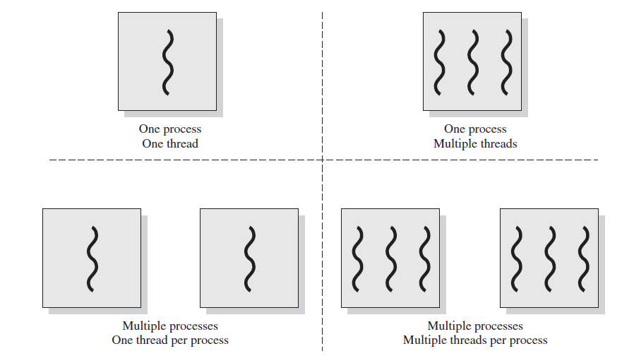
Multithreading refers to the ability of an OS to support multiple, concurrent paths of execution within a single process.

Slide 52
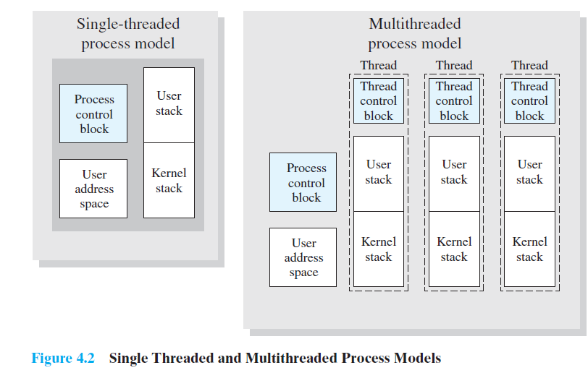

Slide 53
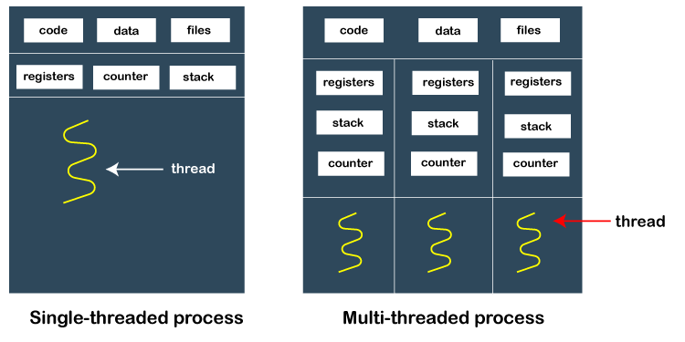
Image courtesy : https://www.javatpoint.com/process-vs-thread

Slide 54
The key benefits of threads
It takes far less time to create a new thread in an existing process than to create a brand-new process.
It takes less time to terminate a thread than a process.

Slide 55
Types of threads
Kernel level threads : managed by kernel
User level threads : managed by user with support from programming languages and libraries
Hybrid threads

Slide 56
Thread
Create
Join
Terminate

Slide 57
Threads
import threading
import time
# Define a function for the thread to execute
def count_numbers(thread_name, count_to):
for i in range(1, count_to + 1):
print(f"{thread_name} counting: {i}")
time.sleep(0.5) # Sleep for half a second
# Create threads
thread1 = threading.Thread(target=count_numbers, args=("Thread 1", 5))
thread2 = threading.Thread(target=count_numbers, args=("Thread 2", 5))
# Start threads
print("Starting threads")
thread1.start()
thread2.start()
# Join threads (wait for them to complete)
thread1.join()
thread2.join()
print("Threads have completed their tasks")

Slide 58
PS C:\Users\Swati> python -u "c:\Users\Swati\Downloads\import threading.py"
Starting threads
Thread 1 counting: 1
Thread 2 counting: 1
Thread 2 counting: 2
Thread 1 counting: 2
Thread 1 counting: 3
Thread 2 counting: 3
Thread 2 counting: 4
Thread 1 counting: 4
Thread 2 counting: 5
Thread 1 counting: 5
Threads have completed their tasks

Slide 59
ULT Vs KLT

Slide 60
Sr No | System Call | Description
1 | fork() | This system calls creates a new process.
2 | exec() | This call is used to execute a new program on a process.
3 | wait() | This call makes a process wait until some event occurs.
4 | exit() | This call makes a process to terminate
5 | getpid() | This system call helps to get the identifier associated with the process.
6 | getppid() | This system call helps to get the identifier associated with the parent process.
7 | nice() | The current process priority can be changed with execution of this system call.
8 | brk() | This call helps to increase or decrease the data segment size of the process.
9 | Kill() | The forced termination of any process can be executed with this system call.
10 | Signal() | This system call is invoked for sending and receiving software interrupts

Slide 61
fork system call
The fork() system call is used to create a new process. When the system executes this system call in response to process creation request, following steps are carried out.
The operating system allocates a slot in the process table for the newly created process.
This new process, i.e. child process is then assigned a unique ID.
System then creates a logical copy of the parent process context.
The file and inode table counters associated with parent process are incremented as this area may be shared between parent process and the child process.
The child process ID is returned to the process and ‘0’ value is assigned to the child process.
All the above steps are carried out in kernel of the parent process.
The control of execution may remain with the parent process, may be transferred to child process or handed over to a third process leaving the parent and child processes in ‘Ready-to-Run’ state.

Slide 62
Processor Scheduling

Slide 63
I/O scheduling Vs Processor Scheduling
I/O Scheduling: I/O scheduling is a process that is involved in making the decision as to which process’s pending I/O request should be handled by an available I/O device.
Processor Scheduling: Processor scheduling is a process that makes a decision of which process should get hold of processor next. This process needs the ‘dispatcher’ – a software module of short term scheduler to make this decision.

Slide 64
I/O bound process: I/O bound processes are the ones those spend more time doing I/O operations than computation, though it may have many short CPU bursts.
CPU bound processes: CPU bound processes spend more time in computations and so they have long CPU bursts. Although they may also involve in very short durations of I/O operations.

Slide 65
Parallelism and Concurrency
Parallelism:
Parallelism is the quality of the processes to execute at the same time.
Two processes or events are said to be parallel if they occur at the same time. In parallelism, multiple processes can be active at a time.
Concurrency:
Concurrency does not mean parallel.
With concurrency, multiple processes are executed one after another by interleaving their execution in such a way that it creates an illusion of parallelism.
In concurrency only one process can be active at a time.

Slide 66
Parallelism and Concurrency
Concurrency is achieved by interleaving process execution on (may be single) CPU which creates an illusion that processes run in parallel,
While parallelism is obtained by multiple processors operating in parallel at a time.
Both the techniques achieve computation speedup, though the inherent mechanism used by both concepts is different.

Slide 67
Advantages of process concurrency.
The processes in a multiprogramming environment are a blend of I/O bound and CPU bound processes.
If these processes are executed sequentially, they underutilize the CPU and I/O devices both.
If executed in interleaved fashion, the system gives better efficiency, relatively lower response, turn around and waiting times.

Slide 68
Process Scheduler
Process scheduler or the Dispatcher is a software module that works for CPU(processor) scheduling and chooses the next process to run.
Its main activities involve switching the process context, switching the execution mode to user.
The dispatcher is required to work very fast to improve the efficiency of execution.

Slide 69
Processor schedulers
Long term scheduler
Mid term scheduler
Short term scheduler

Slide 70
System Calls for Process Management

Slide 71
Questions
?

